Slide 1

Functions

Slide 2
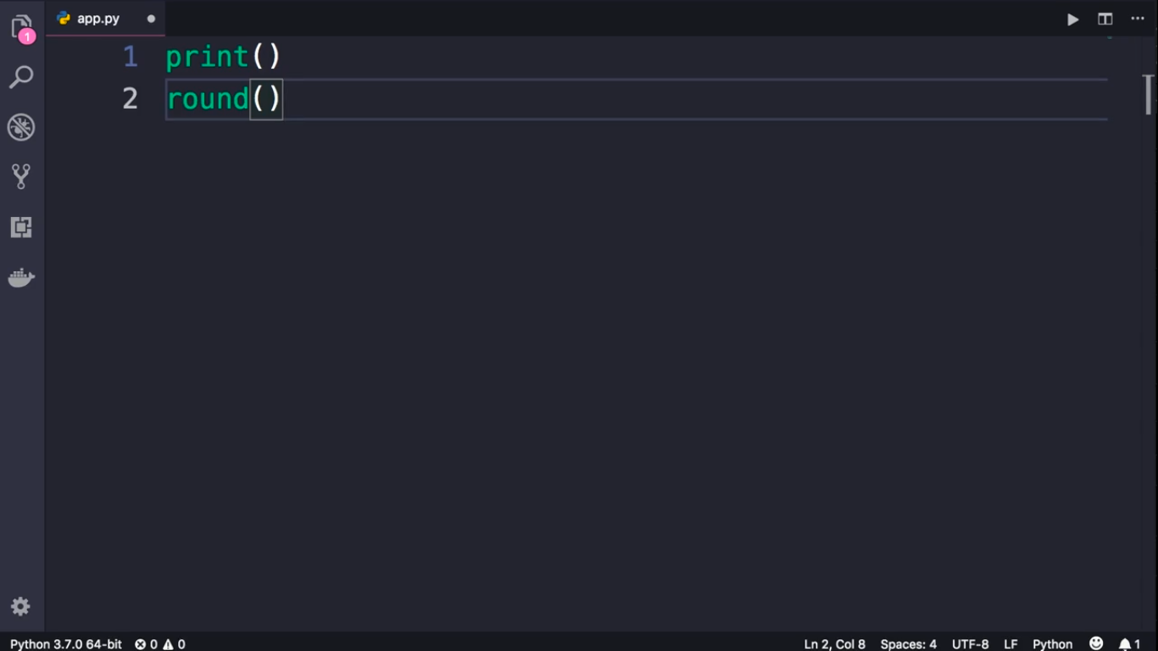
Built-in Function

